Slide 1
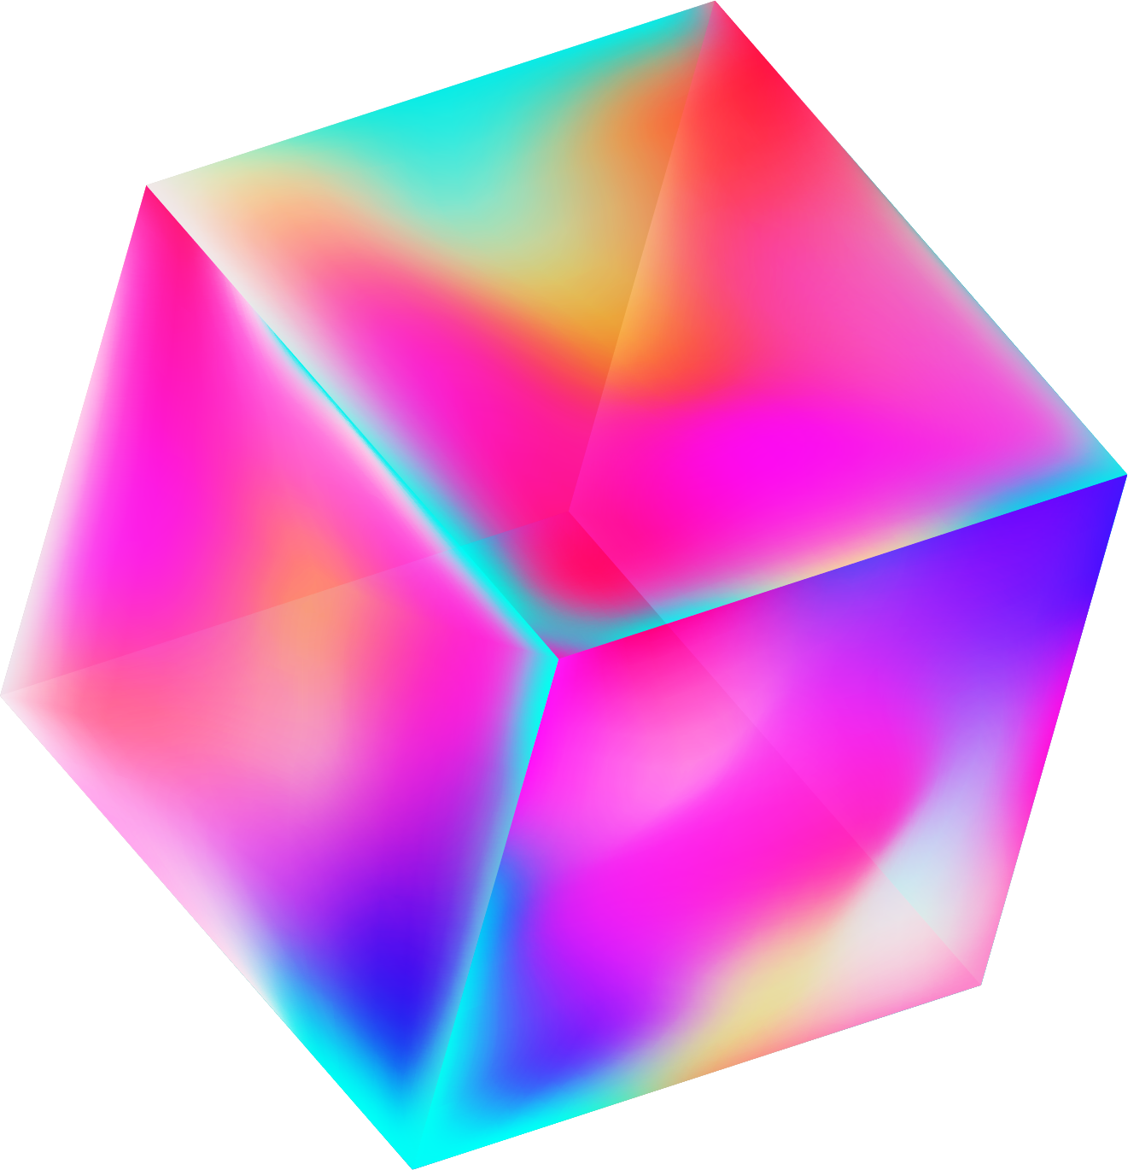


IoT final project part4
S1054004 許書瑋

Slide 2

Directory
01
02
03
Current
剩餘
Communication framework

Slide 3
current
Arduino
Server(cloud)
Duckiebot
程式完成
電腦接收完成
Publishe成功上傳到ros
Mqtt server架設完成
Ros to Mqtt
Mqtt to Ros
程式尚未撰寫

Slide 4
剩餘
Arduino
Server(cloud)
Duckiebot
Subscribe 測試
車道變換測試
影像辨識
變換車道
Ros data

Slide 5
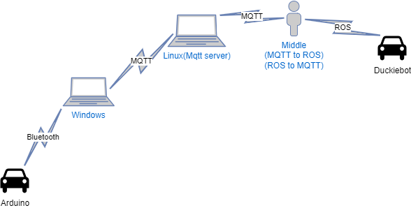
Communication framework

Slide 6
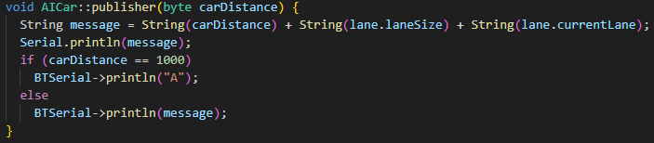
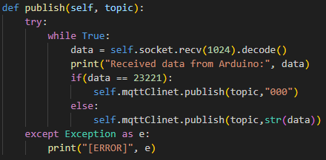
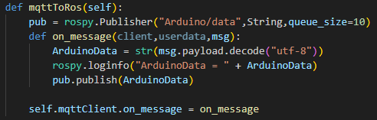
Publish(Arduino)
Arduino to windows
windows to Mqtt server
MQTT to ROS

Slide 7
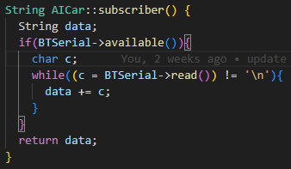
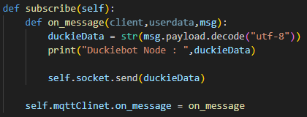
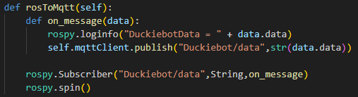
Subscribe(Arduino)
windows to Arduino
Mqtt Server to windows
ROS to Mqtt

Slide 8

Github
https://github.com/sakuranekohon/IoT_final_project.git

